Slide 1
Effective Kubernetes
Keep it Simple
Wojciech Barczyński - Lead Developer | System Engineer
SMACC.io
Notes:
Aka People says K8S runs on your fridge till 2020

Slide 2
Success
Slow delivery
Continuous Deployment?
Fear
Frustration
Technical Debt
XX% Idle Machines

Slide 3





2016

Slide 4
Black (Blue) Box
Infrastructure (almost) invisible
Easy* Continuous Deployment
https://en.wikipedia.org/wiki/File:Dr_Who_(316350537).jpg

Slide 5
Common Language Artifacts Platform
Notes:
The language of Kubernetes let us to use minimum working set, we do need to jump to 100s line Kubernetes configuration files. Verbs

Slide 6

Learn-as-you-go
https://www.flickr.com/photos/bruno_brujah/

Slide 7

Learn-as-you-go
1. Deploy Cloud-Native app
2. Make a Hell of Mistakes
3. Get it right or Postpone
Notes:
We have a powerful tool.

Slide 8
Keep it simple
https://www.flickr.com/photos/bruno_brujah/

Slide 9


Continuous Deployment
Dev
Staging
Prod
Azure Kubernetes Service

Slide 10
Continuous Deployment
make run_local
Code on master → develop env
Development
Notes:
Kelsey Hightower

Slide 11
Continuous Deployment
3. Git tag → staging env
4. PR accepted → production env
Staging
Production

Slide 12
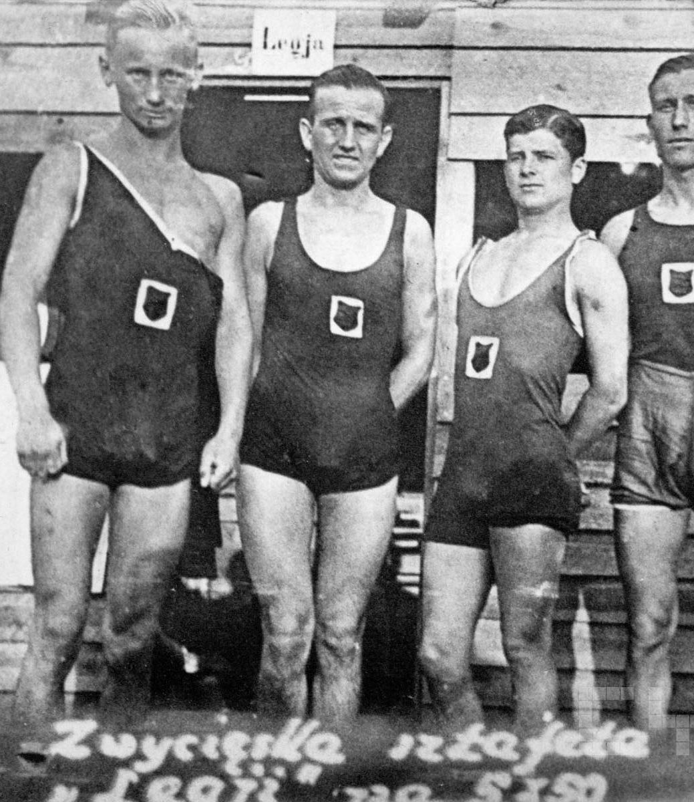
Keep everybody in the process
Teach the team Kubernetes definitions
Keep the CD understandable

Slide 13
Keep everybody in the process
Keep K8S files easy to read
Do not terrorize with amazingly-CD-with-Kubernetes :D

Slide 14
Keep everybody in the process
Copy & Paste:
Makefile
Kubernetes files
TravisCI
curl https://github.com/smacc-ci/deploy.sh | bash

Slide 15
Keep everybody in the process
Copy & Paste:
Makefile
Kubernetes files
TravisCI
curl https://github.com/smacc-ci/deploy.sh | bash
Notes:
Makefile has all what we need for the development process

Slide 16
Conventions over tools!
Common conventions for repos
No a single deploying tool
No encrypted data in repo
ps. Only when you are really really ready.

Slide 17
Application must be way smarter (12factorapps, migrations, coordination, metrics)
https://www.flickr.com/photos/160866001@N07/

Slide 18
Effective Kubernetes
Start with small iterations
Learn-as-you-go
https://www.flickr.com/photos/bruno_brujah/

Slide 19
Effective Kubernetes
Simplicity
Keep your Kubernetes understandable
Hope k8s team keep it this way
https://www.flickr.com/photos/bruno_brujah/

Slide 20

Three ways:
Flow
Feedback
Continuous Experimentation and Learning

Slide 21
Still unknown
Resource limits
Prometheus alert rules
Grafana dashboard definitions
Backup (currently with ARK)

Slide 22
Deployment Services ConfigMap Service Catalog

Slide 23
Long story…
Endpoints:
health/
info/
metrics/
Fast restart

Slide 24
??
Resource limits still hard
Prometheus alert rules still hard
How to get the Grafana dashboard definitions from application
Consider CRT

